Slide 1

Home Assignment
Week - 2 (Prompt Engineering &Techniques)

Slide 2
01
ICEPOT Scenarios
02
Socratic Prompt
03
Chain of Thoughts
CONTENTS
04
Postman Collection

Slide 3
PART 01
ICEPOT TECHNIQUES
Given 3 Scenarios identify what is missing, rebuild the prompt using ICEPOT, run both prompts in an AI tool, and observe the difference in output quality

Slide 4

Scenario 1
Search Functionality
❌ Weak: "Test the search feature."
What's missing: No product type (e-commerce, hospital),
no filter/sort behavior, no empty/invalid input scenarios, no performance angle.

Slide 5
Search Functionality
Instructions
Persona
Generate comprehensive functional, negative, boundary, and performance test scenarios for the Search feature.
Include validation for search behavior, filters, sorting, and error handling.
Act as a Senior QA Automation Engineer with expertise in web, API, usability, accessibility, and performance testing.
Think like a tester preparing regression-ready test scenarios for a production release.
Context
Output Format
The application is an e-commerce website with product search, category filters, price filters, and sorting options.
Consider valid, invalid, empty, special character, partial keyword, and large dataset search scenarios.
Present the results in a markdown table with Test Scenario ID, Test Scenario, Expected Result, and Priority.
Categorize scenarios into Positive, Negative, Boundary, Performance, Security, and Accessibility.
Examples
Example: Search "iPhone" and verify relevant products are displayed with correct sorting.
Example: Search an invalid product name and verify a "No products found" message is displayed.
Tone
Keep the response professional, structured, and suitable for JIRA/Xray test case creation.
Ensure the scenarios are concise, realistic, and follow industry QA best practices.

Slide 6
Scenario 2
FILE UPLOAD
❌ Weak: "Generate test cases for file upload."
What's missing: No file types, no size limits,
no success/failure criteria, no security angle (malicious file upload).

Slide 7
FILE UPLOAD
Instructions
Persona
Generate comprehensive manual and API test cases for the File Upload functionality.
Include positive, negative, boundary, security, usability, and performance scenarios.
Act as a Senior QA Engineer with expertise in web application, API, and security testing.
Create test cases that are suitable for execution and automation.
Context
Output Format
The application allows users to upload PDF, JPG, PNG, and DOCX files up to 10 MB. Reject unsupported file types, oversized files, corrupted files, duplicate uploads, and malicious files while displaying appropriate error messages.
Present the output in a table with Test Case ID, Scenario, Test Steps, Test Data, Expected Result, Priority, and Test Type.
Group the test cases into Functional, Negative, Boundary, Security, and Performance categories.
Examples
Example valid upload: Resume.pdf (2 MB) → Upload succeeds with a success message.
Example invalid upload: malware.exe or image.png (15 MB) → Upload is blocked with the correct validation error.
Tone
Use a professional, structured, and concise testing style.
Ensure the test cases are practical, complete, and aligned with real-world QA standards.

Slide 8
Scenario 3
Role Based Access control
❌ Weak: "Write test cases for user roles."
What's missing: No role types (Admin, Manager, Viewer),
no permission matrix, no unauthorized access scenarios, no app domain.

Slide 9
Role Based Access Control
Instructions
Persona
Generate comprehensive test cases for a file upload functionality. Include positive, negative, validation, security, and permission-based scenarios.
Act as a Senior QA Engineer with expertise in API, UI, security, and functional testing for enterprise applications.
Context
Output Format
The application allows users to upload files. Validate file upload behavior based on supported file types, file size limits, duplicate files, corrupted files, and user access permissions.
Provide test cases in a structured format with Test Scenario, Preconditions, Test Steps, Test Data, Expected Result, and Priority.
Examples
Tone
Example scenarios: Admin can upload all allowed files, Viewer has restricted upload access, invalid file formats should be rejected, and oversized files should display validation messages.
Use a professional and detailed QA documentation style suitable for sharing with developers, product owners, and stakeholders.

Slide 10
Please enter title content here
Title text addition
Title text addition
The user can demonstrate on a projector or computer, or print the presentation and make it film
The user can demonstrate on a projector or computer, or print the presentation and make it film
Title text addition
Title text addition
The user can demonstrate on a projector or computer, or print the presentation and make it film
The user can demonstrate on a projector or computer, or print the presentation and make it film

Slide 11
PART 02
Socratic Technique
Primarily belongs in the ideation, planning, and problem-diagnosis workflow steps

Slide 12
Socratic Technique
What is
Socratic prompting is the practice of interrogating an AI model output rather than accepting it at face value. Developers use it to surface assumptions, test reasoning, expose edge cases, and improve the quality of generated answers or code.
Why to use
It builds critical thinking: It mimics a great teacher. Instead of handing you the answer, it helps you figure it out yourself.It uncovers hidden assumptions: It challenges your biases.It prevents "AI Hallucinations": It forces the AI to check its own work before giving a final response
When to use
When learning something new: Use this when studying a complex subject (like law, math, or coding) so you truly learn the material instead of just memorizing it.
When you are stuck on a problem: Use this for brainstorming when you are not sure where to start. The AI's questions will help you break down the problem.
When testing a big idea: Use this to critique your own business plan or project. Ask the AI: "What are the hidden assumptions in my plan?" or "What would make my idea fail?"

Slide 13
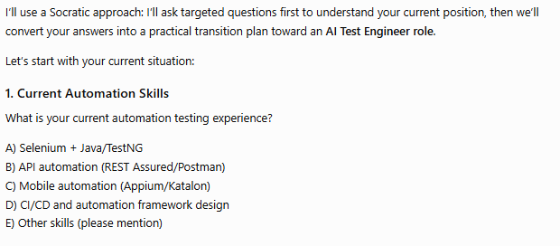
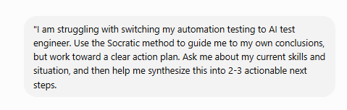


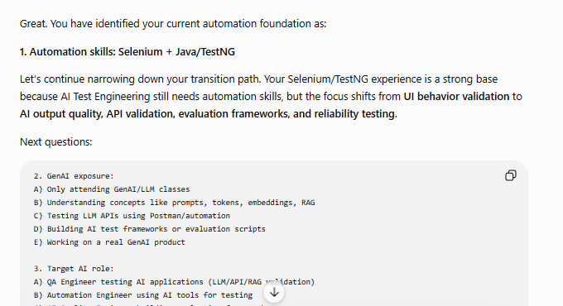


Slide 14

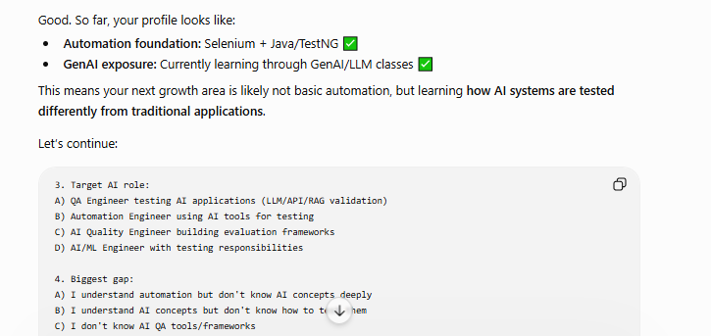

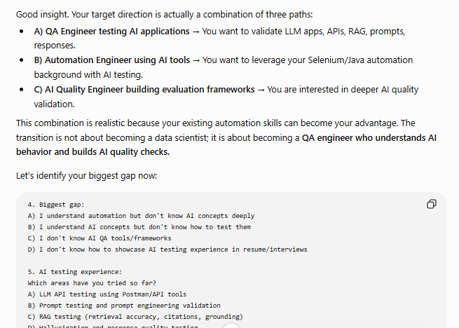

Slide 15

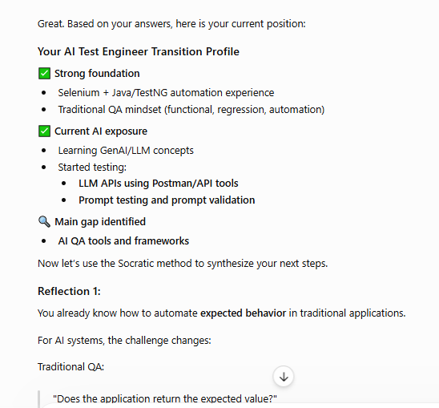

Slide 16
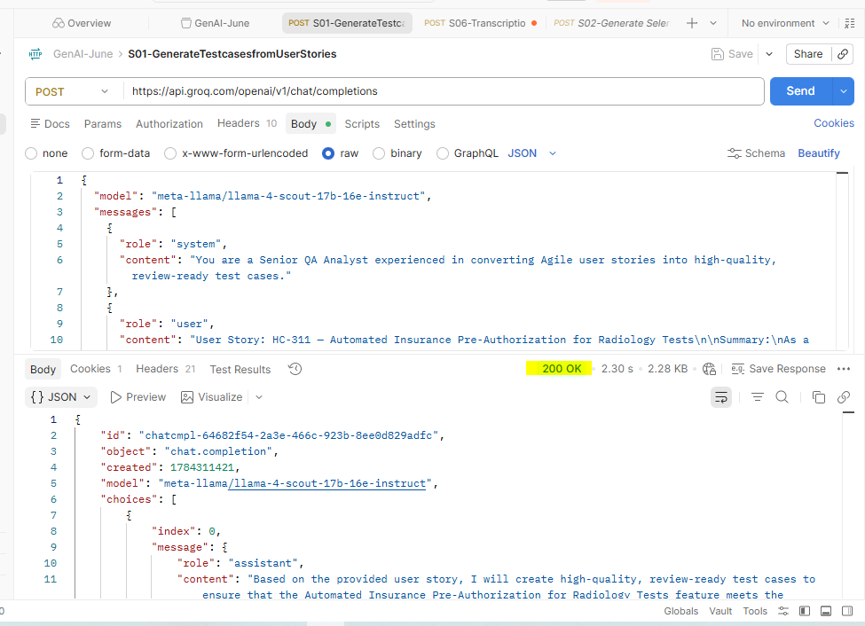
Postman Collection
Header- https://api.groq.com/openai/v1/chat/completions

Slide 17
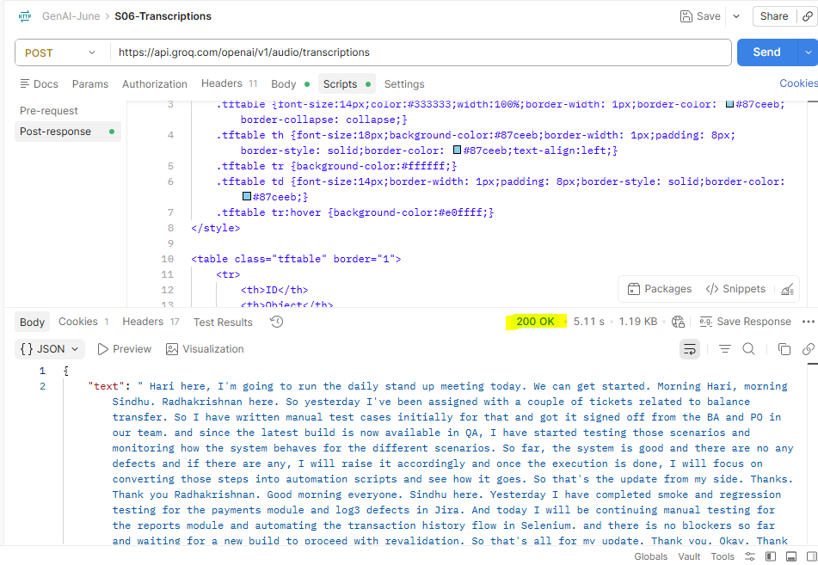
Postman Collection
https://api.groq.com/openai/v1/audio/transcriptions

Slide 18
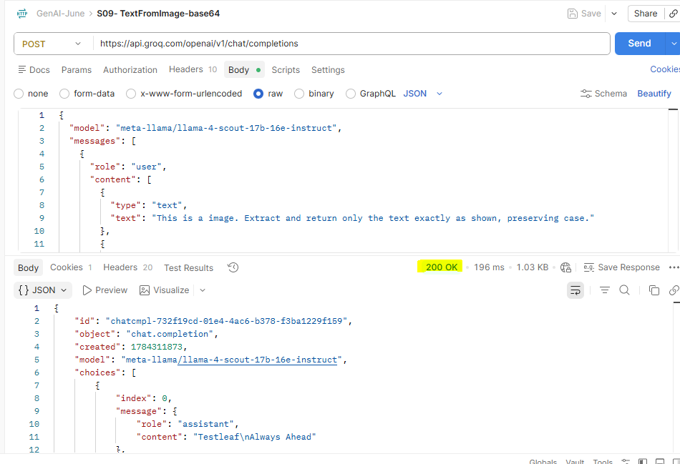
Postman Collection
https://api.groq.com/openai/v1/chat/completions

Slide 19
Thank you
By- JyothiSushma E

